Slide 1

ss
UNDERSTANDING CUSTOMER DEMOGRAPHICS, PURCHASING PATTERNS AND PRODUCT INSIGHTS.
Objective:
This report delivers a comprehensive analysis of customer demographics and purchasing behavior. By examining sales trends across age groups, customer segments, and payment methods, the goal is to uncover actionable insights that improve customer engagement , and optimize sales strategies to drive business growth.

Slide 2
ss
KEY PERFOMANCE INDICATORS (KPIs)
TOTAL PRODUCTS
10
TOTAL CUSTOMERS
13k
TOTAL SALES
3.30m
TOTAL TRANSACTIONS
13K
AVERAGE SALES
254.36K
TOTAL STOCK QUANTITY
13.05K

Slide 3


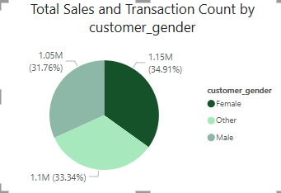

ss
Analyzing purchasing behavior by Gender
Females made the highest number of purchases with 4,445 transactions (34.25%), followed by Other (4,358 – 33.58%) and Males (4,174 – 32.16%).
In terms of Total Sales, Females generated ₦1.15M (34.91%)slightly ahead of Males at ₦1.1M(33.34%) with an and Others at ₦1.05M(31.76%).
Females has a higher avg sale per transaction compared to other genders.
(Females: 259.21, Male: 252.51, other:251.13).
KEY INSIGHTS: Female customer generate the highest transaction volume and total sales showing slightly higher purchasing power compared to other genders. This indicate product alignment with female buyers.
Female(4346 customers)
Total sales -1.15m(34.91%) & AVG sale (259.21)
Transaction count – 4445(34.25%)
Male(4356 customers)
Total sales -1.1m(33.34%) & AVG sale (252.51)
Transaction count – 4358(32.16%)
Other(4174 customers)
Total sales -1.05m(31.76%) & AVG sale (251.13)
Transaction count – 4174(33.58%)

Slide 4
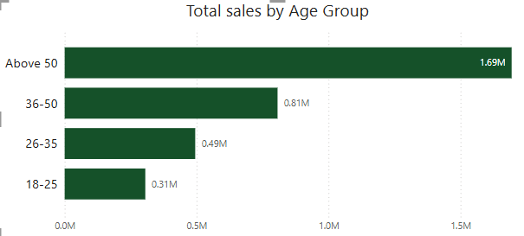
ss
Analyzing purchasing behavior By Age Group
Analyzing total sales by age group helps us identify which age group generates more revenue.
50+ Age group generates the highest sales of 1.69M with a higher transaction of 6622.
18-25 has a higher avg sale per transaction of 264.63 despite generating the lowest total sales.
(50+:255.78, 36-50:250.38, 26-35:250.11, 18-25:264.63).
25-36 : 0.49M, Transaction count:1978
36 -50 : 0.81M, Transaction count:3222
50+ : 1.69M, Transaction count:6622
18- 25 : 0. 31M, Transaction count:1155
No of Customers: 6581
No of Customers:3803
No of Customers: 2046
No of Customers: 1336

Slide 5
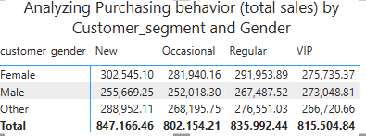
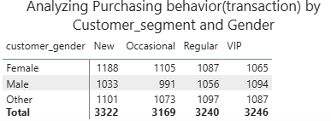
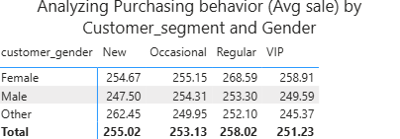
ss
Analyzing Purchasing behavior by Customer Segment & Gender
Analyzing purchasing behavior across four customer segments (New, VIP, Regular, and Occasional) by gender.
Key Observations:
Female customers consistently lead in transaction count across all segments, with the highest activity in the New segment (35.76% of transactions).
New customers (Female) generated the highest sales ₦302K(35.71%) among that segment.
Regular female customers has the highest avg sale per transaction (268.59) which implies they spend more per transaction.

Slide 6
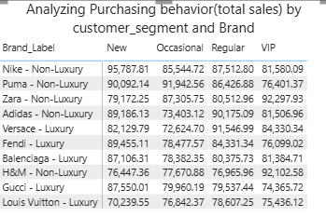
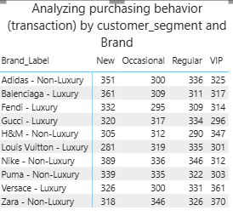
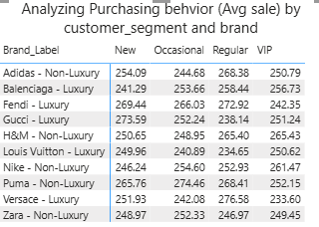
ss
Analyzing Purchasing behavior by Customer Segment & Brands
Regular customers have more high transaction count for luxury brands.
Regular customers has the highest avg sale per transaction for Versace (276.58) showing a strong preference for luxury brands.

Slide 7
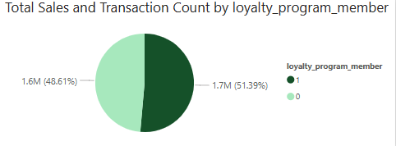
ss
Analyzing purchasing behavior By Loyalty Program Member
Loyal Members
Total sales:₦1.7m( 51.5%)
Non-Loyal Members
Total sales:₦1.6m (48.5%)
Transaction count:6640
Transaction count:6637
Avg sale per transaction: 255.47
Avg sale per transaction:253.19
Loyal members generated ₦1.7M(51.5%) slightly higher than non-members at ₦1.6M(48.5%).
Both loyal & Non-members had nearly equal transactions.
(Loyal members:6640,Non members:6637)
Average sale per transaction was slightly higher for loyal members.(₦255.47 vs. ₦253.19).
KEY INSIGHTS: The loyalty program appears to slightly boost purchasing power.

Slide 8
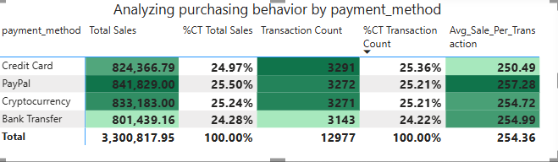
ss
Analyzing Purchasing behavior by Payment Method.
Analyzing payment methods across both total sales and transaction volume.
PayPal: Highest total sales (₦841.83K) and avg.sale (₦257.28) with fewer transactions.
Credit card: Highest transactions(3,291) but lower sales (₦824.37K) and avg.sale(₦250.49)
Key Insight:
This reveals that PayPal users tend to make fewer but higher-value purchases, indicating a segment with slightly higher purchasing power and credit card users purchase more frequently.
PAYPAL: 25.5% (₦841.83K)
CRYPTOCURRENCY: 25.24% (₦833.18K)
CREDIT CARD: 24.97% (₦824.37K)
BANK TRANSFER: 24.28% (₦801.44K)

Slide 9
ss
Analyzing Purchasing power By Customer Segment & Payment Method
Analyzing total sales by customer segment & payment method reveals sales distribution across four customer segments.
New customers
Crypto: highest sales & transaction count(₦236,700k),(28.8%).
Credit card: highest avg sale per transaction(₦256.41).
Vip customers
Bank transfer: Highest sales & transaction count (₦216,373k),(27%) with top avg sale (₦259.75)
Occasional customers
PayPal: Highest sales & transaction count (₦217,100k), (25%) with top avg sale (₦265.44)
Regular customers
PayPal: Highest sales & transaction count (₦218,263k),(25.9%). Crypto: Highest avg sale per transaction (₦259.30)

Slide 10
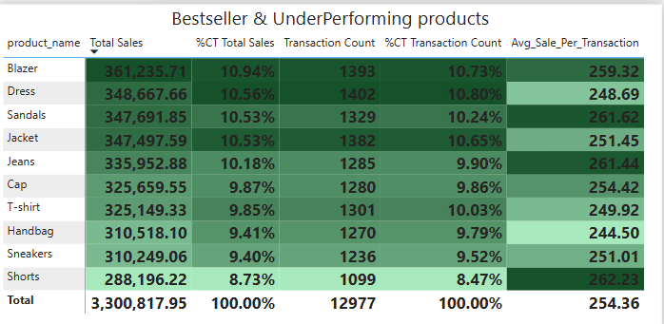
ss
Analyzing best seller & underperforming Products
Analyzing total sales by product item reveals both top-selling and underperforming products.
Blazer has the highest revenue at ₦0.36M with 1,393 transactions.
Dress has the highest transaction count of 1,402, but slightly lower revenue of ₦0.34M
Shorts has the lowest revenue (₦0.29M) and lowest transaction count(1099) making it our underperforming products but also has the highest average sale per transaction(262.23).
Best seller
Dress : (₦0.34M), transaction count -1402
Underperforming item
Shorts: (₦0.29M), transaction count-1099

Slide 11
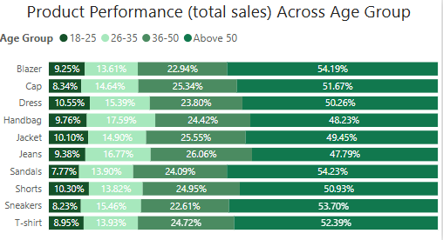
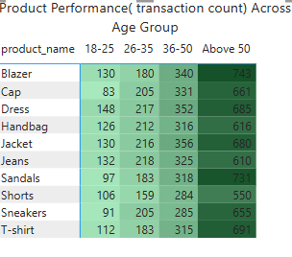
ss
Product performance by age group
Key insights:
Best Seller Products
50+: Blazer & Sandals.
36-50: Jacket & dress
26-35: Jeans & jackets
18-25: Dress & Jackets
Underperforming Products
50+: Shorts & Handbags.
36-50: Shorts & Sneakers.
26-35: Shorts & T-shirts.
18-25: Shorts & Caps.

Slide 12
ss
Customer demographics.
Top Age Group: Customers aged 50+ generate the highest sales.(₦1.69M)
Loyalty Impact: Loyalty members drive 51% of total sales and has a higher transaction count.
Gender Based: Females made the highest number of purchases with 4,445 transactions (34.25%), followed by Other (4,358 – 33.58%) and Males (4,174 – 32.16%).
Payment Preference: Credit card and PayPal are our top payment customer preferences and PayPal has the highest revenue of 841.83.
Customer Segment: New female customers generates the highest total sales(₦ 302,000) & regular female customers tend to spend more per transaction.
Best selling and underperforming products.
Best Seller: Dress has the highest transaction count of 1,402 but a lower revenue of ₦0.34M.
Underperforming Item: Shorts has the lowest revenue (₦0.29M) and lowest transaction count(1099) and a high avg sale per transaction(262.63).
Highest Sales by product: Blazer has the highest sales (₦0.36M) and transaction count of 1393.
Age group trends: Above 50 has the highest sales across all products.
SUMMARY

Slide 13
ss
RECOMMENDATIONS
1. Gender-Based Product Targeting:
Leverage gender insights to tailor product promotions. Since female customers generated slightly higher total sales and transaction volume, focus marketing efforts on products that resonate well with them such as Dresses while also ensuring product alignment with male and other customer preferences.
2. Product Stocking & Inventory Planning:
Use product performance data (sales & transaction count) to guide inventory decisions. Blazers and Dresses were top sellers, while Shorts had low demand. Focus restocking on high-demand items and consider promotions or bundling for underperforming ones.
3. Payment Method Optimization:
Highlight and optimize high-performing payment channels. Since PayPal drives higher revenue per transaction, promote it across platforms, while also improving the experience for Credit Card and Crypto users especially for high-volume customer groups.
4. Customer Segment-Focused Promotions:
Create personalized experiences based on customer segments. New customers showed high average spend via Credit Card and strong interest in Cryptocurrency. Use welcome offers or preferred payment promotions to encourage repeat purchases from this group.

Slide 14
ss
CONCLUSION
In Conclusion, our analysis of customer demographics, purchasing behavior and product performance has provided actionable insights. By identifying high-performing products, key customer segments and preferred payment methods. we can make more targeted decisions to drive growth, improve marketing strategies and optimize inventory.

